Slide 1
Unit 1
HTTP and the Web Services

Slide 2
Hypertext Transfer Protocol (HTTP)
The Hypertext Transfer Protocol (HTTP) is an application protocol for distributed, collaborative, hypermedia information systems. HTTP is the foundation of data communication for the World Wide Web
It is Protocol for transfer of various data formats between server and client (Plaintext, Hypertext, Images, Video, Sound ) and Meta –information
Hypertext Transport Protocol is a Language of the Web, protocol used for communication between web browsers and web servers, use TCP port 80 (443 secure)
Hypertext is structured text that uses logical links (hyperlinks) between nodes containing text. HTTP is the protocol to exchange or transfer hypertext
The standards development of HTTP was coordinated by the Internet Engineering Task Force (IETF) and the World Wide Web Consortium (W3C), culminating in the publication of a series of Requests for Comments (RFCs), most notably RFC 2616

Slide 3
Technical Overview
HTTP functions as a request-response protocol in the client-server computing model.
The client submits an HTTP request message to the server. The server, which provides resources such as HTML files and other content, or performs other functions on behalf of the client, returns a response message to the client. The response contains completion status information about the request and may also contain requested content in its message body.
HTTP is an application layer protocol designed within the framework of the Internet Protocol Suite. Its definition presumes an underlying and reliable transport layer protocol and Transmission Control Protocol (TCP) is commonly used. However HTTP can use unreliable protocols such as the User Datagram Protocol (UDP)
HTTP resources are identified and located on the network by Uniform Resource Identifiers (URIs)—or, more specifically, Uniform Resource Locators (URLs)—using the http or https URI schemes

Slide 4
HTTP - URLs
URL
Uniform Resource Locator
protocol (http, ftp, news)
host name (name, domain name)
port (usually 80 but many on 8080)
directory path to the resource
resource name
http://xxx.myplace.com/www/index.html
http://xxx.myplace.com:80/cgi-bin/t.exe

Slide 5
HTTP Request methods
HTTP defines methods to indicate the desired action to be performed on the identified resource.
The HTTP/1.0 specification defined 3 Method
GET
The GET method is used to ask for a specific document , when we click on a hyperlink, GET is being used
run a CGI with arguments attached to the URL
POST
The POST method is used to transfer block of data from the client to the server
more secure and private
HEAD
The HEAD method is used to ask only for information about a document, not for the document itself.
It's often used by clients who use caching, to see if the document has changed since it was last accessed

Slide 6
Contd..
HTTP/1.1 specification added 5 new methods:
OPTIONS
Returns the HTTP methods that the server supports for the specified URL. This can be used to check the functionality of a web server by requesting '*' instead of a specific resource.
PUT
Requests that the enclosed entity be stored under the supplied URI. If the URI refers to an already existing resource, it is modified; if the URI does not point to an existing resource, then the server can create the resource with that URI
DELETE
Deletes specified resource object, Usually Not allowed
TRACE
Echoes back the received request so that a client can see what (if any) changes or additions have been made by intermediate servers
CONNECT
Converts the request connection to a transparent TCP/IP tunnel, usually to facilitate SSL-encrypted communication (HTTPS) through an unencrypted HTTP proxy

Slide 7
HTTP Response Headers
Sent by server to client browser
Status Header
Entities
Content-Encoding:
Content-Length:
Content-Type:
Expires:
Last-Modified:
extension-header
Body – content (usually html)

Slide 8
Status Codes
200 OK
201 created
202 accepted
204 no content
301 moved perm.
302 moved temp
304 not modified
400 bad request
401 unauthorized
403 forbidden
404 not found
500 int. server error
501 not impl.
502 bad gateway
503 svc not avail

Slide 9
Statelessness
Because of the Connect, Request, Response, Disconnect nature of HTTP it is said to be a stateless protocol
i.e. from one web page to the next there is nothing in the protocol that allows a web program to maintain program “state” (like a desktop program).
“state” can be maintained by “witchery” or “trickery” if it is needed

Slide 10
Web servers
A web server is a Server that processes requests via HTTP, the basic network protocol used to distribute information on the World Wide Web.
The term can refer either to the entire computer system, an appliance, or specifically to the software that accepts and supervises the HTTP requests
Web servers are computers that deliver (serves up) Web pages.
Every Web server has an IP address and possibly a domain name.
The primary function of a web server is to store, process and deliver web pages to clients.
The communication between client and server takes place using the Hypertext Transfer Protocol (HTTP).
Pages delivered are most frequently HTML documents, which may include images, style sheets and scripts in addition to text content.

Slide 11
Working of Web servers
A user agent, commonly a web browser or web crawler, initiates communication by making a request for a specific resource using HTTP and the server responds with the content of that resource or an error message if unable to do so.
The resource is typically a real file on the server's secondary storage, but this is not necessarily the case and depends on how the web server is implemented.
While the primary function is to serve content, a full implementation of HTTP also includes ways of receiving content from clients. This feature is used for submitting web forms, including uploading of files.
Many generic web servers also support server-side scripting using Active Server Pages (ASP), PHP, or other scripting languages.

Slide 12
Common features
Virtual hosting to serve many web sites using one IP address
Large file support to be able to serve files whose size is greater than 2 GB on 32 bit OS
Bandwidth throttling to limit the speed of responses in order to not saturate the network and to be able to serve more clients
Server-side scripting to generate dynamic web pages, still keeping web server and website implementations separate from each other
Logging
Security (e.g., access control)
Traffic analysis
Require centralized data structures to implement

Slide 13
Load limits
A web server (program) has defined load limits, because it can handle only a limited number of concurrent client connections (usually between 2 and 80,000, by default between 500 and 1,000) per IP address (and TCP port) and it can serve only a certain maximum number of requests per second depending on:
its own settings,
the HTTP request type,
whether the content is static or dynamic,
whether the content is cached, and
the hardware and software limitations of the OS of the computer on which the web server runs.
When a web server is near to or over its limit, it becomes unresponsive.

Slide 14
Causes of overload
Too much legitimate web traffic.
Distributed Denial of Service attacks. A denial-of-service attack is an attempt to make a computer or network resource unavailable to its intended users;
Computer worms that sometimes cause abnormal traffic because of millions of infected computers (not coordinated among them);
XSS viruses can cause high traffic because of millions of infected browsers and/or web servers;
Internet bots Traffic not filtered/limited on large web sites with very few resources (bandwidth, etc.);
Internet (network) slowdowns, so that client requests are served more slowly and the number of connections increases so much that server limits are reached;
Web servers (computers) partial unavailability. This can happen because of required or urgent maintenance or upgrade, hardware or software failures, back-end (e.g., database) failures, etc.; in these cases the remaining web servers get too much traffic and become overloaded

Slide 15
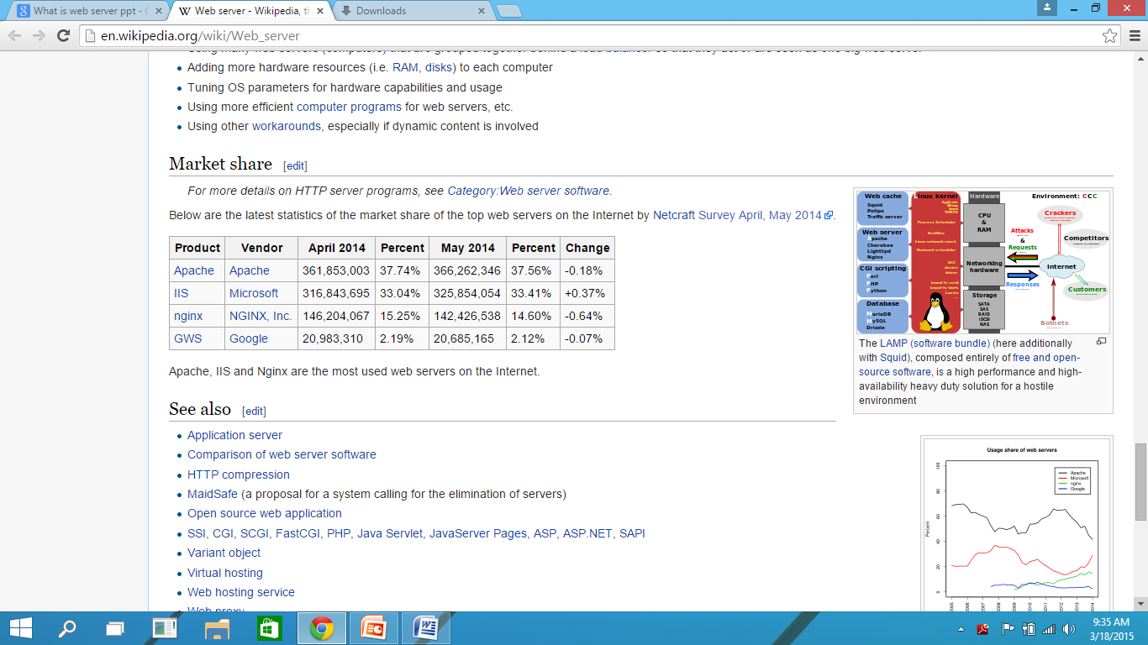
Market share

Slide 16
Web Access
Web Access is retrieving web documents in world wide web using internet
We use some client application called web browser to access web document.
We Access in world wide web, plain hypertext documents, video, audio, images, animation or some other web services
Some services are e-commerce, web portals, search engines, e-banking, e-payments, online educations, Journals, news portals etc

